Slide 2

Life Expectancy Analysis
Group 19: Nguyen Quang Minh
Ly Nhat Nam
Luong Hoang Anh
Le Van Hoang
Supervisor: Dr. Nguyen Binh Minh

Slide 3
I- Introduction

Slide 4

Introduction
Life expectancy, a key indicator of national health, reflects a combination of social, political, economic and environmental factors, along with the standard of medical care. To better understand the dynamics of longevity in a changing global landscape, political experts, health care providers, and analysts need extensive knowledge.

Slide 5
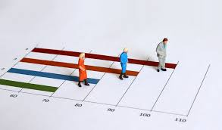
Introduction
The objective of this report is to study the association between economic development and life expectancy, especially focusing on the relationship between GDP per capita and life expectancy in different geographical areas. It is predicted that life expectancy will increase due to medical developments and internationalization of health care programs, however, the influence of many different variables on health requires careful consideration.

Slide 6
II - Data

Slide 7
Data overview
The dataset includes information on life expectancy, health factors, and economic data for 193 countries, collected from 2000 to 2015. Noteworthy progress in the health sector, particularly in developing nations, has been observed over the past 15 years. Initial data inspection revealed missing values, primarily for population, Hepatitis B, and GDP, with most gaps in less-known countries.
The final dataset comprises 22 columns, 2938 rows, and 20 predicting variables, categorized into Immunization, Mortality, Economic, and Social factors.

Slide 8
Data overview
Here are the dataset attributes:
Country | Year | Status | Life expectancy | Adult Mortality | Infant death | Alcohol | Percentage Expenditure | Hepatitis B | Measles | BMI
under-five deaths | Polio | Total expenditure | Diphtheria | HIV/AIDS | GDP | Population | thinness 1-19 years | thinness 5-9 years | Income composition of resources | Schooling

Slide 9
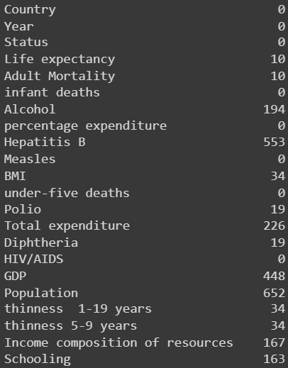
Data preprocessing
Numerous null values in this dataset with different approaches to handle based on the context of the data:
For ‘life expectancy’ attribute, we simply remove all null values from the dataset
‘Population’ null values will not be replaced and will remain untouched to keep the authentication
The remaining missing values of attribute such as GDP, BMI, mortality, alcohol consumption, HepB, polio, diphtheria, thinness, income, schooling will simply be replaced by 0.
Figure 1. Total number of missing values in each attribute.

Slide 10
Data preprocessing
Next task: rounding numeric values
Alcohol, percentage expenditure, income composition values will be rounded to 2 decimal places
BMI, GDP, thinness, schooling will be rounded to only 1 decimal place.
The remaining numerical values will be rounded to integer

Slide 11
III – Data analysis and findings

Slide 12
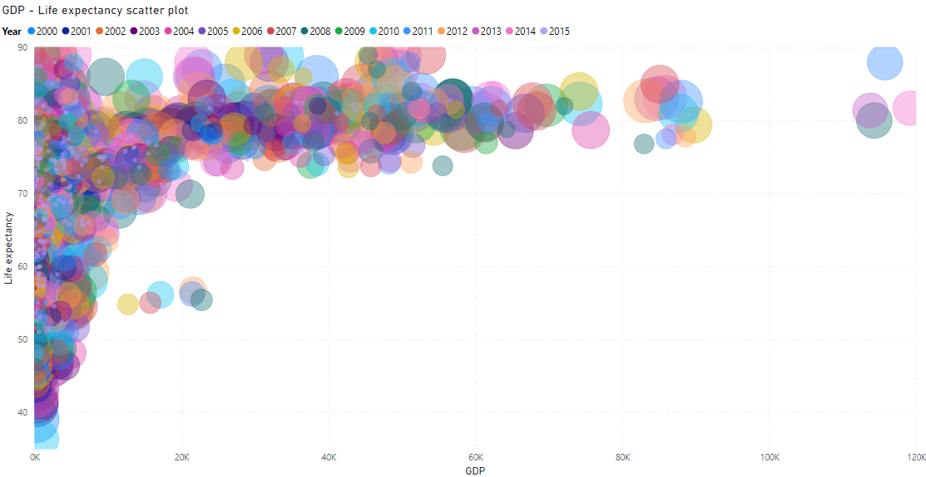
GDP – Life expectancy correlation
GDP – Life expectancy correlation
Overview of GDP per capita – life expectancy correlation:

Slide 13
GDP – Life expectancy correlation:
GDP – Life expectancy correlation
Overview of GDP per capita – life expectancy correlation:
In general, for all countries listed in the dataset, there is a strong correlation between GDP per capita and life expectancy. Countries with high GDP tend to have high life expectancy.

Slide 14
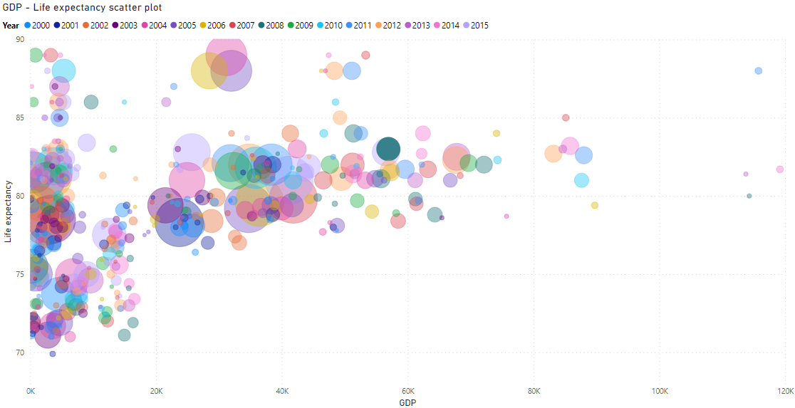
GDP – Life expectancy correlation
GDP – Life expectancy correlation
GDP per capita – Life expectancy correlation for developed countries

Slide 15
GDP – Life expectancy correlation
GDP – Life expectancy correlation
GDP per capita – Life expectancy correlation for developed countries
There are a lot of countries with high GDP per capita, whose numbers could go up to over 100k USD.
With regards to life expectancy, these countries are also among the highest at over 80 years of age.
However, among the 0 to 20k GDP range there are still a lot of countries with high age expectancy due to the fact that they have high expenditure on health, a significant characteristic of developed countries.

Slide 16
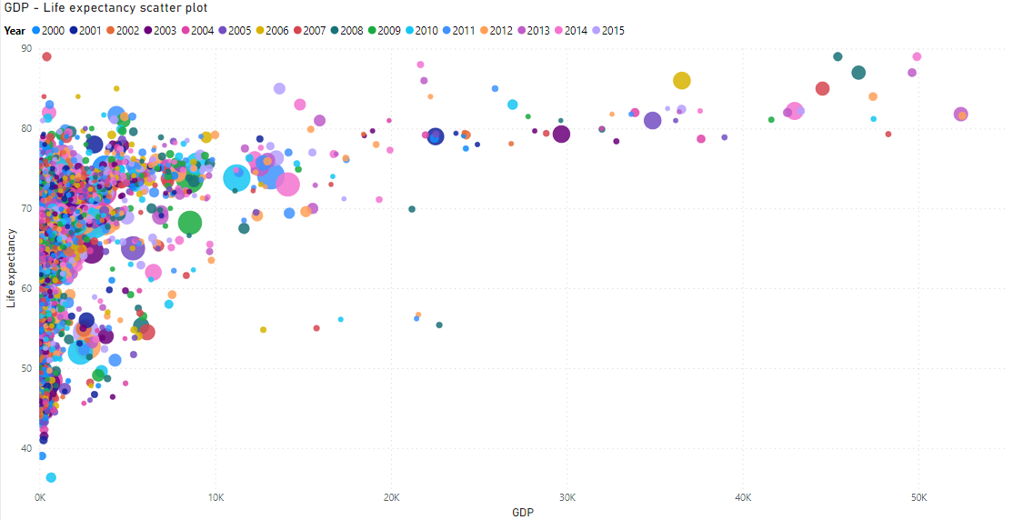
GDP – Life expectancy correlation
GDP – Life expectancy correlation
GDP per capita – Life expectancy correlation for developing countries

Slide 17
GDP – Life expectancy correlation
GDP – Life expectancy correlation
GDP per capita – Life expectancy correlation for developing countries
The GDP per capita isn’t as high as the number of developed countries, as the highest only reaches over 50K USD.
However, they share the same characteristics as the high life expectancy strongly correlated with high GDP per capita.
As expected of developing countries with low GDP per capita, the duration of a person living in these countries’ life are among the lowest with some could go even below 50 years of age

Slide 18
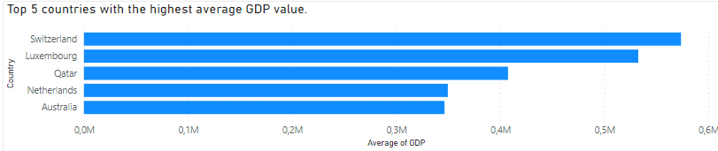
GDP – Life expectancy correlation
General overview for GDP and life expectancy
Switzerland holds the top spot in average GDP per capita at approximately 573,629 USD, demonstrating a notable deviation from its counterparts. Luxembourg follows closely behind at 532,570 USD per capita, with Qatar securing the third position at 407,484 USD per capita. In the same top 5 ranking, the Netherlands and Australia exhibit close values, standing at 349,647 and 346,375 USD per capita, respectively.

Slide 19
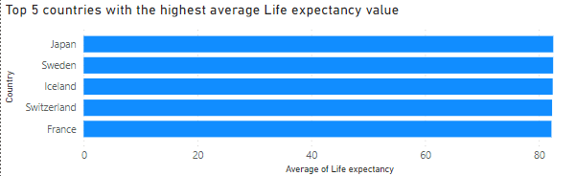
GDP – Life expectancy correlation
General overview for GDP and life expectancy
The top 5 countries with the highest average life expectancy from 2000 to 2015 are Japan (82.54 years), Sweden (82.52), Iceland (82.44), Switzerland (82.33), and France (82.22). Upon analysis, it's evident that, in general, developed nations tend to have higher average life expectancies compared to developing countries. Notably, within the top 5, France is classified as a developing country based on data from 2000-2015.

Slide 20
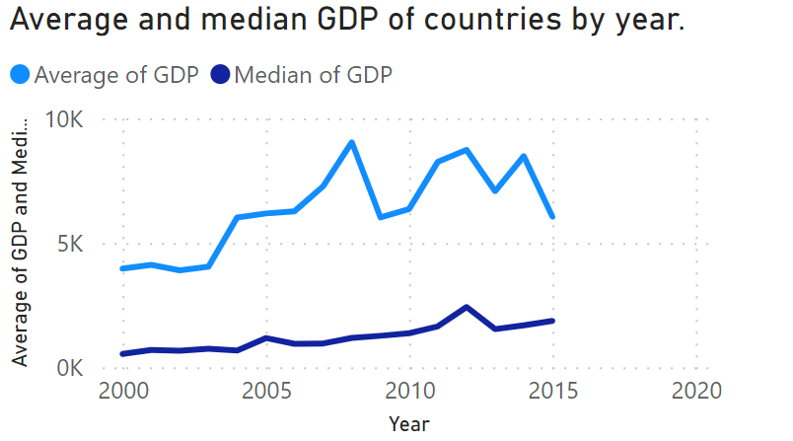
GDP – Life expectancy correlation
General overview for GDP and life expectancy
The line chart for average GDP from 2000 to 2015 reveals a slight overall increase, with notable fluctuations during the interim period. The GDP steadily climbed from 2000 to 2008, peaking at approximately 9040 USD per capita. However, post-2008 saw a sharp decline to the lowest value of 6019 USD per capita by 2015.
In contrast, the median GDP value displays more stable fluctuations, reaching its lowest point of around 534 USD per capita in 2000 and reaching a zenith of 2423 USD per capita in 2012.

Slide 21
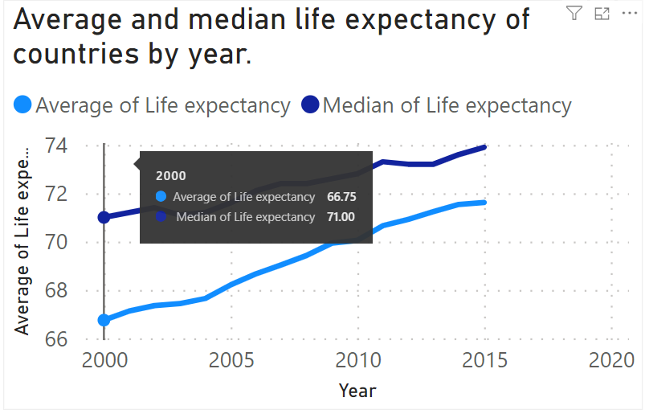
GDP – Life expectancy correlation
General overview for GDP and life expectancy
Unlike the GDP line chart, life expectancy shows a consistent upward trend with only a slight dip in 2003. Examining the chart, we observe a significant increase from 2000 to 2015, with the average life expectancy rising from 67 to nearly 72 years. Similarly, the median value increased from 71 to 74 years. This underscores a notable enhancement in life development over the specified period.

Slide 22
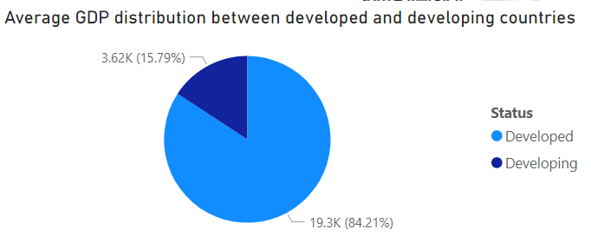
GDP – Life expectancy correlation
General overview for GDP and life expectancy
The pie chart on the left shows that developed countries have a significantly higher average GDP compared to developing countries.

Slide 23
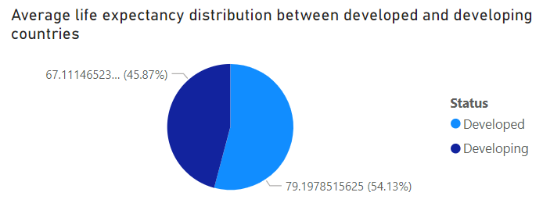
GDP – Life expectancy correlation
General overview for GDP and life expectancy
The pie chart on the right presents data on average life expectancy. Although developed countries still hold an edge, the disparity is less pronounced compared to GDP. The blue slice representing developed countries accounts for about 45.87%(67 years) of the average life expectancy, while the dark blue slice for developing countries makes up roughly 54.13% (79years) .
-> This translates to a difference of about 12 years between the two groups.

Slide 24
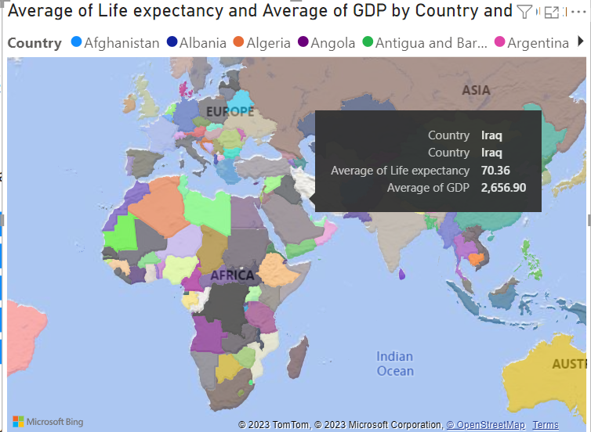
GDP – Life expectancy correlation
General overview for GDP and life expectancy
World map showing the average value of GDP and life expectancy of countries around the world (2000-2015):

Slide 25
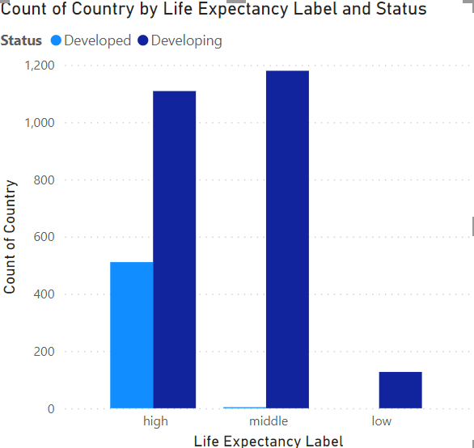
GDP – Life expectancy correlation
Life Expectancy Influence
Overview
Life expectancy labels
+ High life expectancy (> 70 years) -> both the developed and developing countries
+ Middle life expectancy (70-50 year) -> only the developing countries
+ Low life expectancy ( < 50 year) -> only the developing countries
Influent Feature on life expectancy
+ Alcohol: recorded per capita (15+) consumption (in liters of pure alcohol)
+ Schooling: the average number of years that people in a country do their schooling
+ Total expenditure: general government expenditure on health as a percentage of total government expenditure (%)
+ HDI(Human Development Index) on income resource: Human Development Index in terms of income composition of resources (index ranging from 0 to 1)
+ BMI(Body mass Index): Average Body Mass Index of the entire population
+ Children deaths: number of children deaths per 1000 population
+ Vaccination :immunization coverage among 1-year-olds (%)
+ Health expenditure percentage: expenditure on health as a percentage of Gross Domestic Product per capita(%)

Slide 26
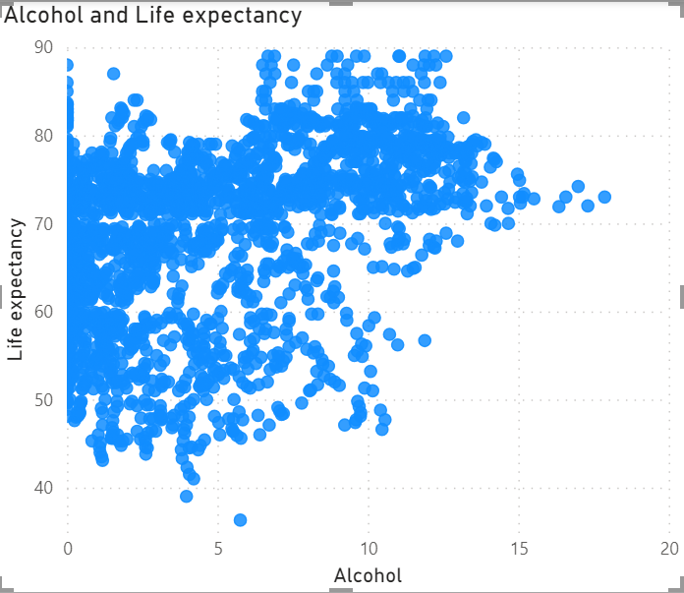
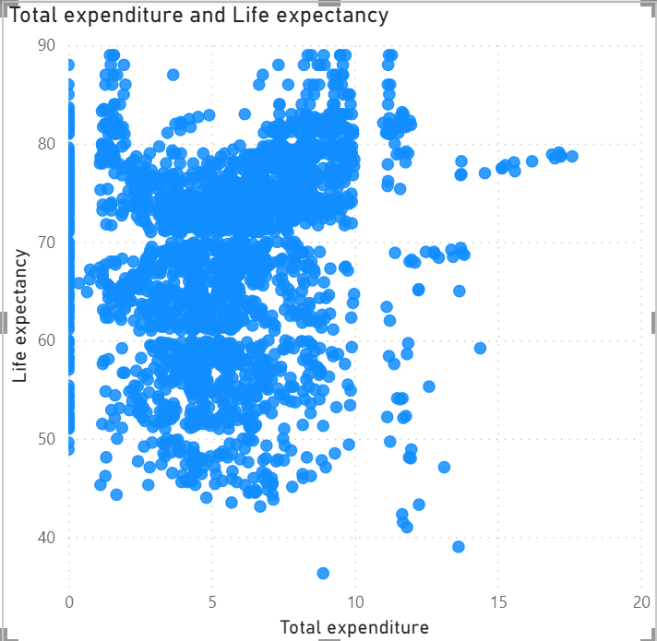
Life Expectancy Influence
1. Alcohol and total expenditure
- There is no difference between high life expectancy and low life expectancy
- The high life expectancy have a higher consumption of alcohol than the low life expectancy
- In every country, healthcare plays an important role in government strategy
+ Developed countries may come from the high cost for medical support and medicine
+ Developing countries this cost may come from the number of patients cured.

Slide 27
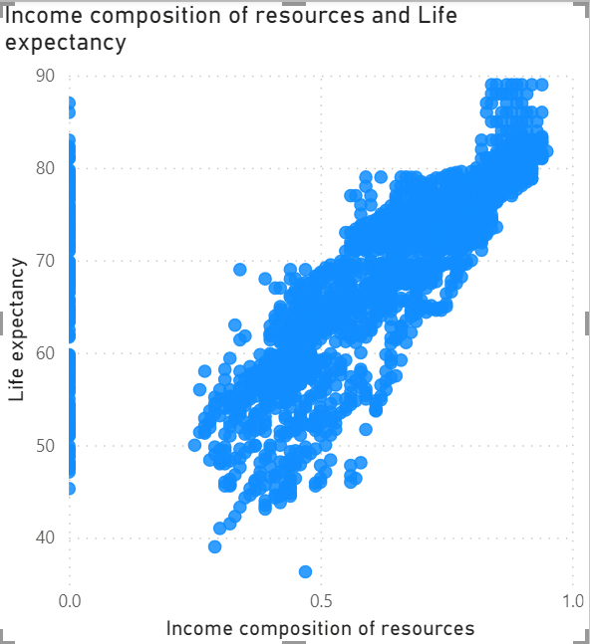
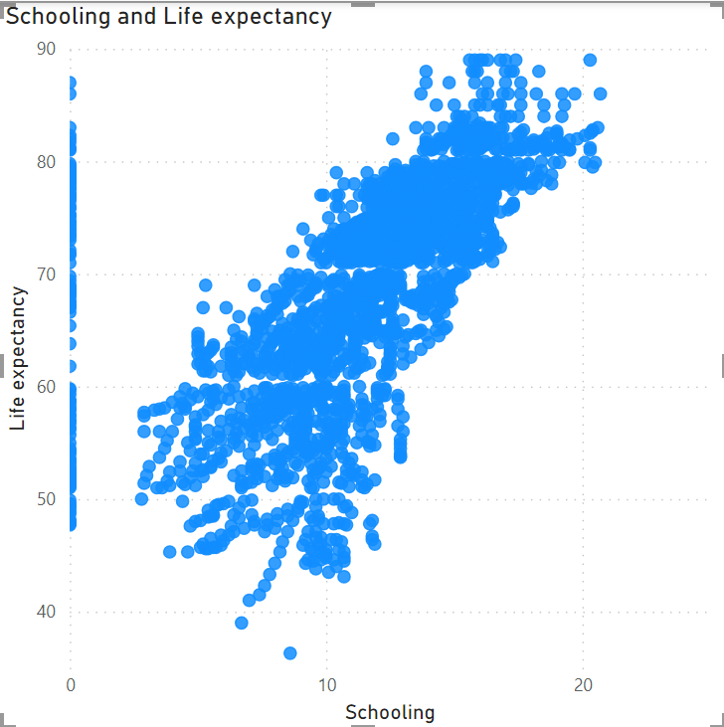
Life Expectancy Influence
2. HDI and Schooling
- Is in direct proportion to life expectancy, the higher value, the higher life expectancy.
- Low life expectancy countries HDI is approximately around 0.5 while in high life expectancy, the index is in the range from 0.7 to 1.0
- The low life expectancy is corresponding with the number of schooling years less than 10 while the life expectancy is over 10

Slide 28
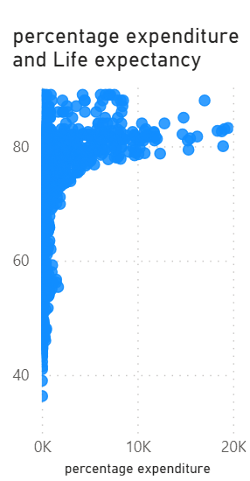
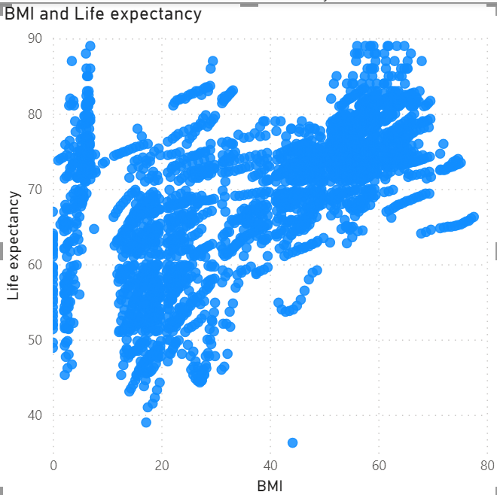
Life Expectancy Influence
3. BMI and Expenditure compared with GDP
- In high life expectancy countries, the BMI index cover wide range but focus on the part > 40 (obesity) -> the advance in technology and medical systems of developed countries
- Low life expectancy countries have an underweight body -> poverty, starvation and wars.
-

Slide 29
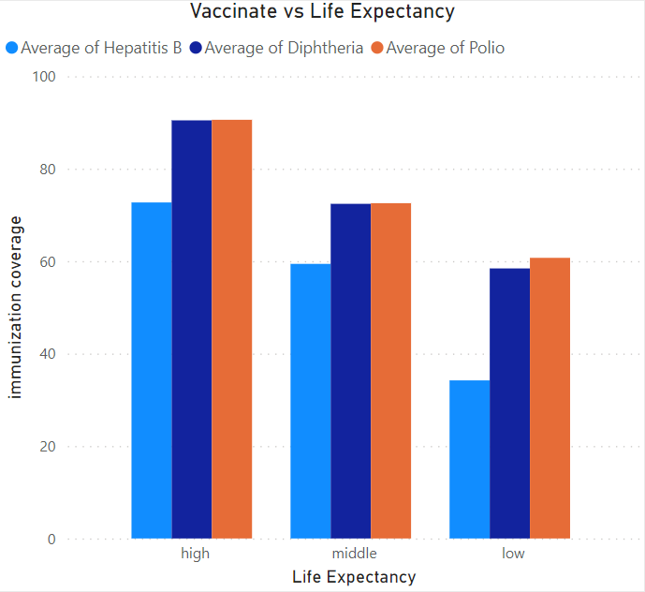
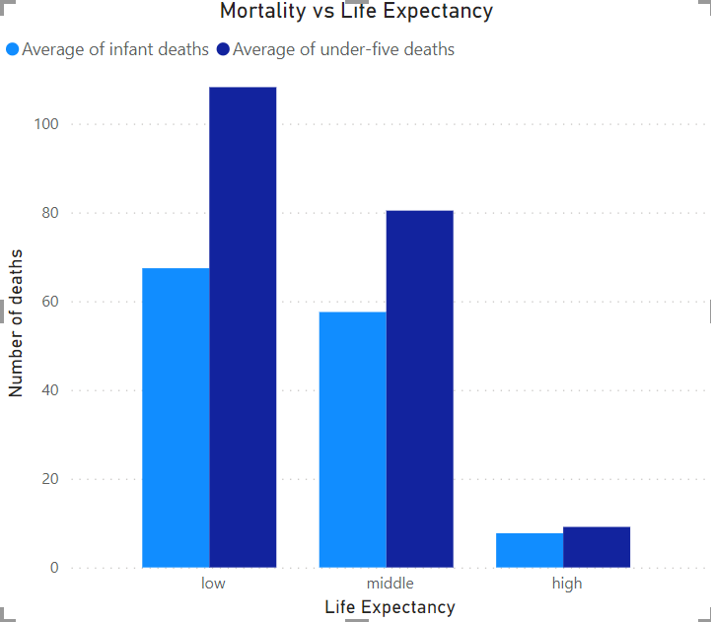
Life Expectancy Influence
4. Children deaths rate and Vaccination
- With children’s deaths Low life expectancy is high (up to over 100 cases average per 1000 population) while in high expectancy countries is only 15 for average.
- With vaccination ,the high life expectancy countries get the highest immunization coverage among 1-year-olds while those in low countries are only around 60% with Polio, Diphtheria and 35% with Hepatitis B.

Slide 30
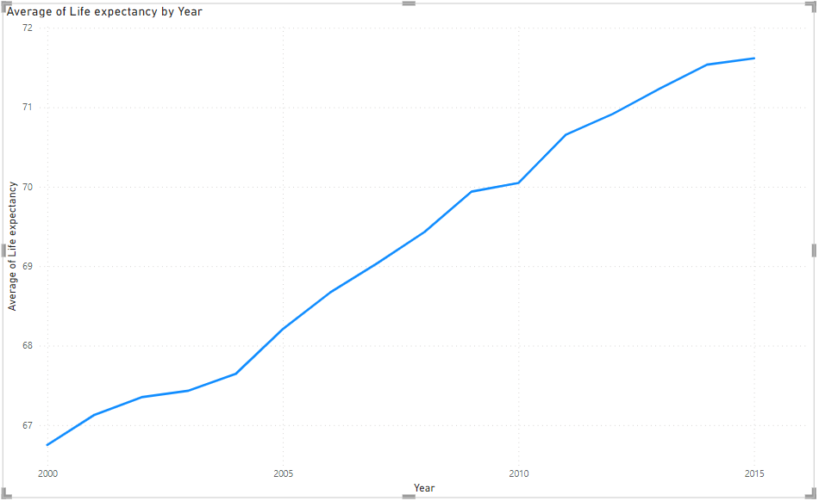
Trends in Life Expectancy
Trend in Life Expectancy
Overall global trend
Initial Point (2000): The graph indicates the starting average life expectancy at 66.75 years.
Final Point (2015): A notable increase is seen by the end of the period, with an average life expectancy of 71.62 years.
Increment: the overall progression suggests improvement in global health standards

Slide 31
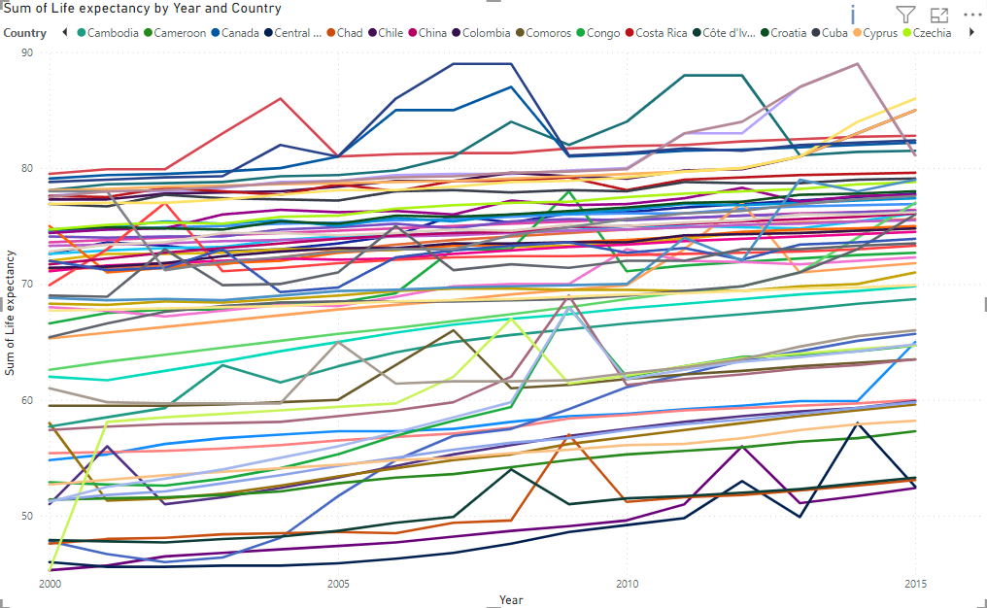
Trends in Life Expectancy
Overview and Identification of Trends
Trend in life expectancy of country can be divided into 2 groups: stable and unstable

Slide 32
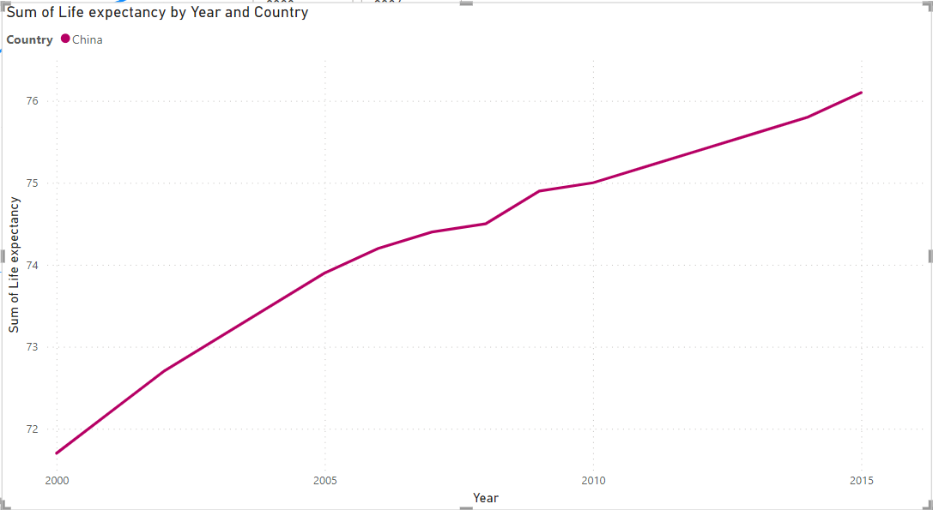
Trends in Life Expectancy
Stable Life Expectancy Trends
Some countries, like China, had very small changes in life expectancy, from slightly higher to slightly lower compared to last year.
This consistency is probably a result of ongoing improvements in healthcare accessibility

Slide 33
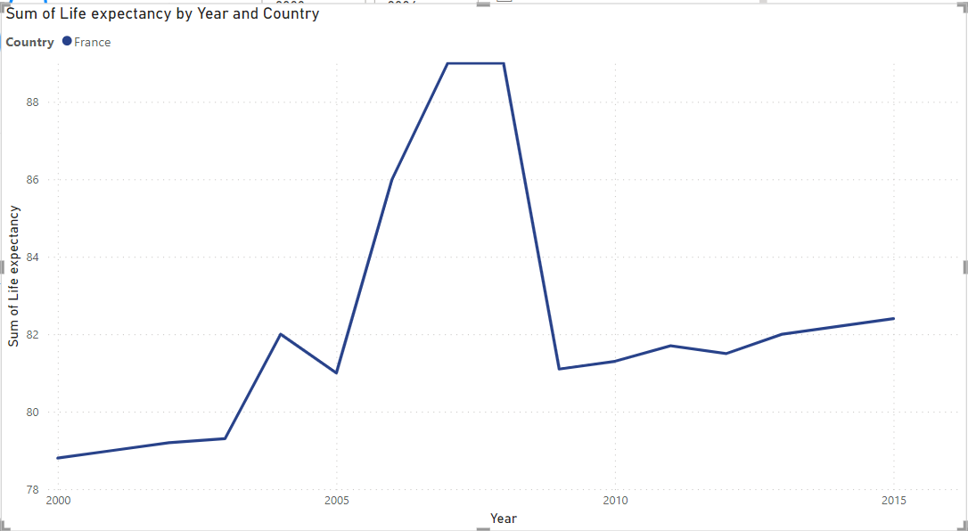
Trends in Life Expectancy
Unstable Life Expectancy Trends
On the other hand, certain country have experienced significant variations in life expectancy
In example: France, specially from 2005 to 2009
These sudden shifts demonstrate how susceptible health outcomes are to both internal and environmental factors.

Slide 34
THANK YOU !

